Slide 1
Evolution of Computer
From Abacus to Artificial Intelligence
Presented by:
Jashwant, Aman & Manish

Slide 2
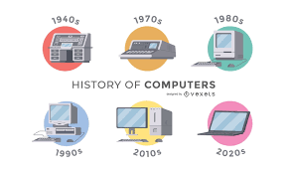
Introduction
Computer = An electronic device for calculation & processing
Today, it is part of education, business, science, entertainment.
Evolution shows how technology improved over time.

Slide 3
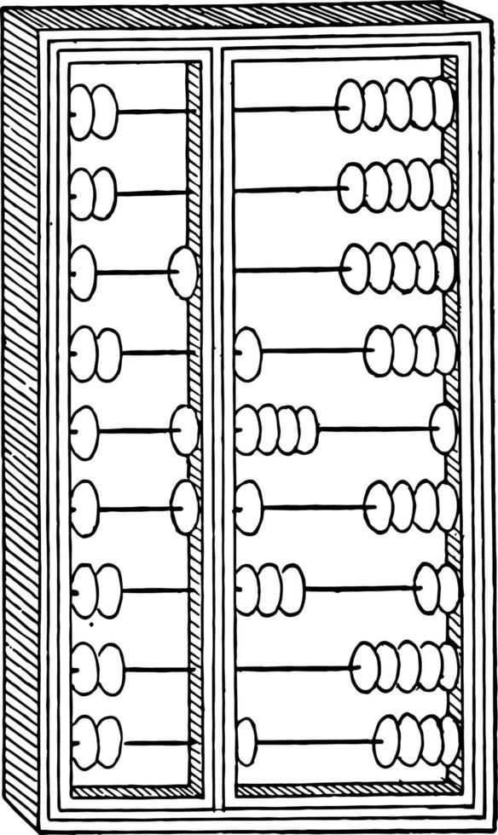
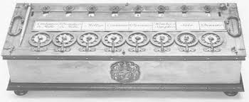
Early calculating device
Abacus – first calculating (~3000 BC).
Napier’s Bones – for multiplication (1617).
Pascal’s Calculator – mechanical adder (1642).
Leibniz calculator - multiplication & division(1673).

Slide 4
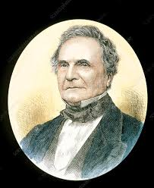
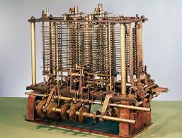
Mechanical Computers
Charles Babbage – Father of Computers
Different Engine.
Analytical Engine.
Ada Lovelace – First Programmer.

Slide 5
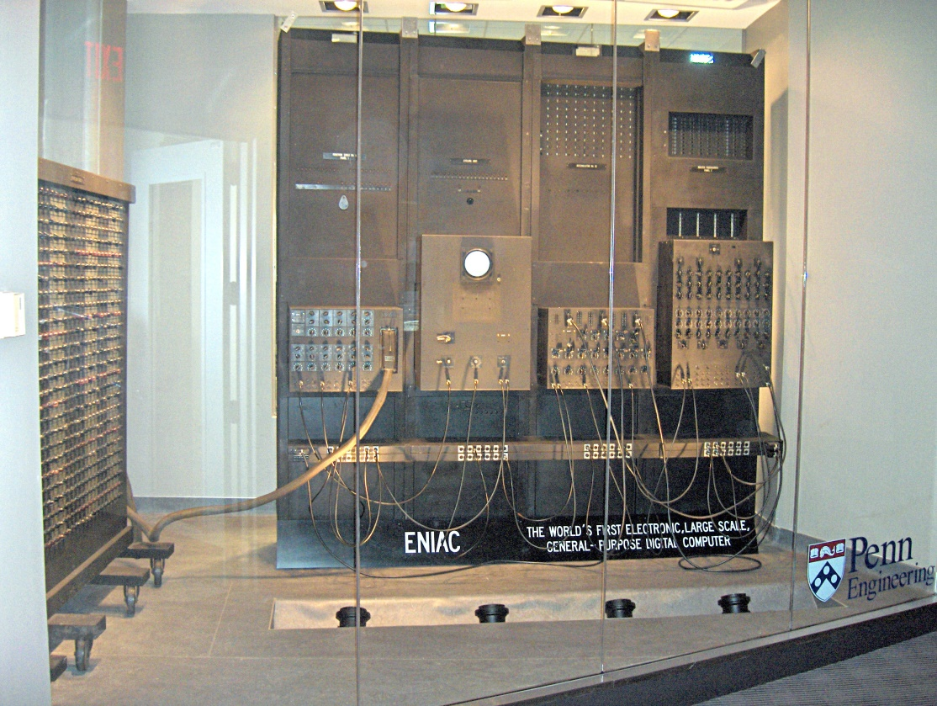
First Generation (1940-1956)
Technology: Vacuum Tubes.
Very large & generated heat.
Slow & expensive
Example: ENIAC, UNIVAC.
Language: Machine Language.

Slide 6
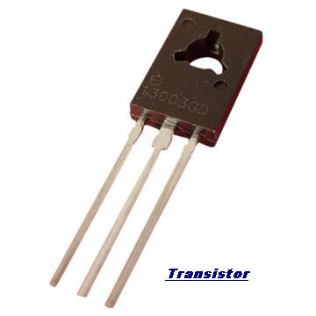
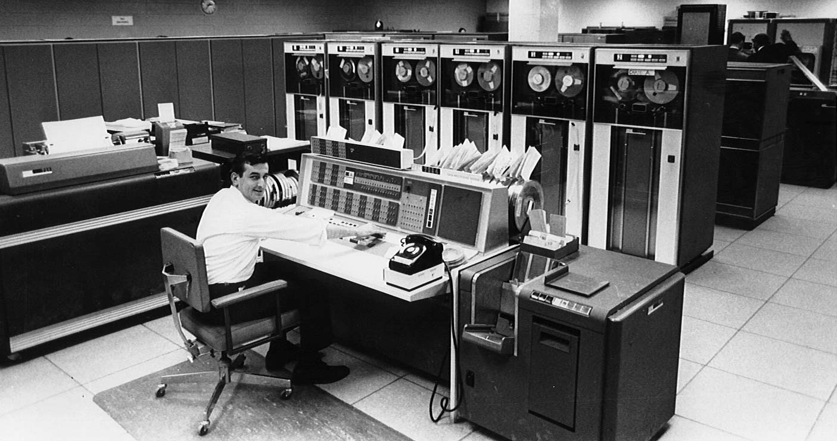
Second Generation (1956-1963)
Technolgy: Transistors.
Faster, smaller, reliable.
Example: IBM 7094, CDC 1604
Programming: Assembly, FORTRAN, COBOL.

Slide 7
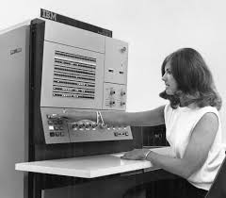
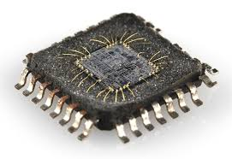
Third Generation(1964-1971)
Technology: Integrated Circuits(ICs)
Smaller, efficient, cheaper.
Example: IBM 360 series
Multiprogramming Introduced

Slide 8
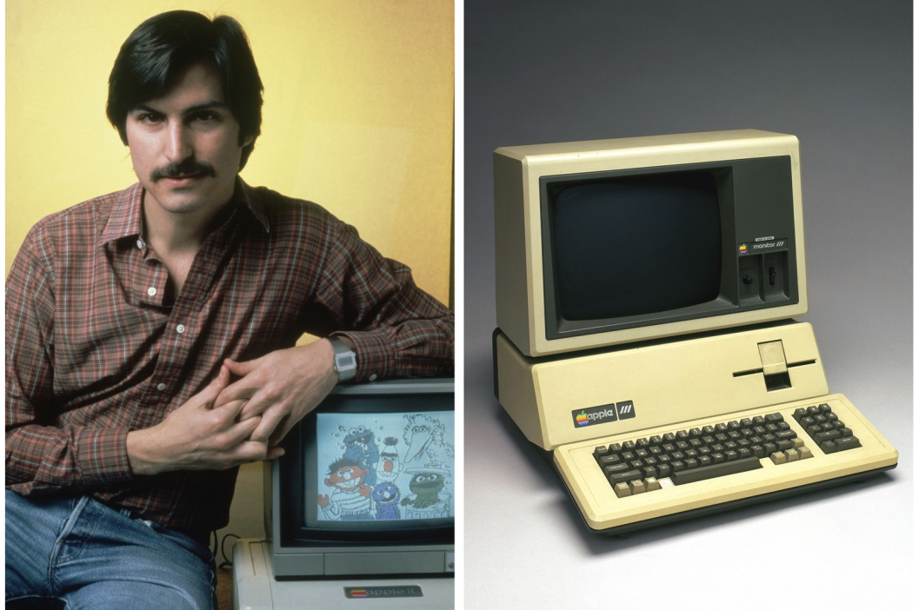
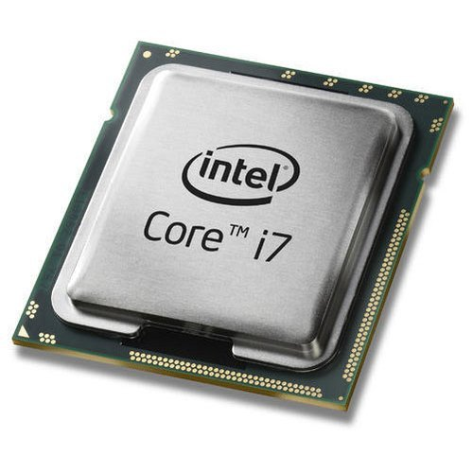
Fourth Generation(1971-Present)
Technology- Microprocessors.
Personal Computers (PCs) introduced.
GUI, Mouse, Networking developed.
Example: Apple, IBM Pc.

Slide 9
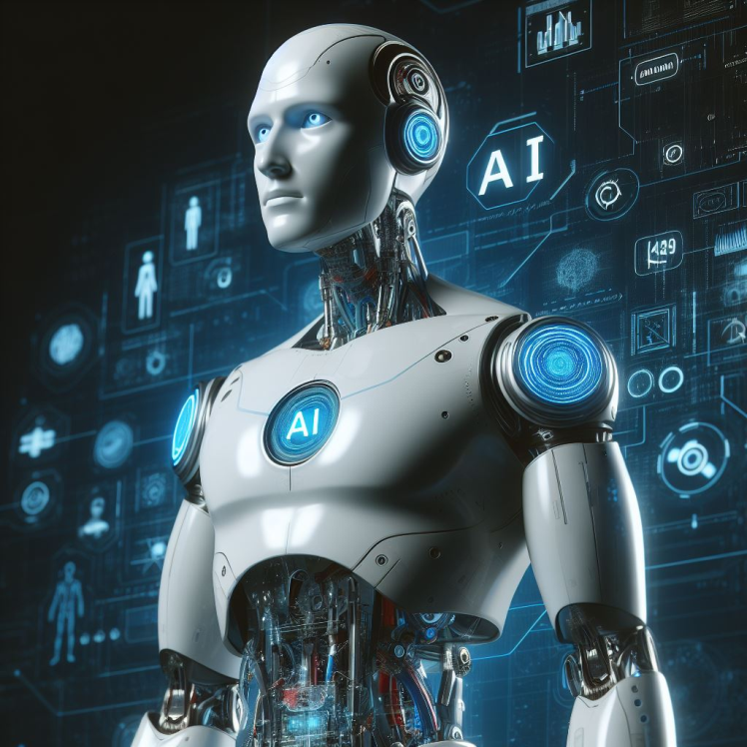
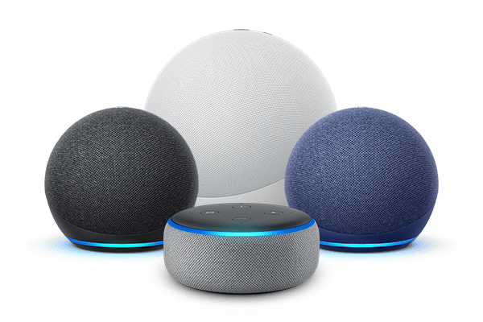
Fifth Generation (Present & Future)
Technology: Artificial Intelligence(AI)
Features: Natural Language Processing, Robotics, Machine Learning
Example: Siri, Alexa, Self-driving cars.

Slide 10
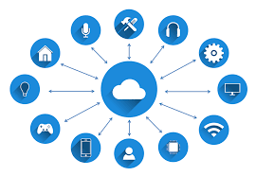
Modern Trends
Cloud Computing – data storage online.
Quantum Computing – super fast future computers.
Internet of Things(IOT) – smart devices(watches, homes).

Slide 11
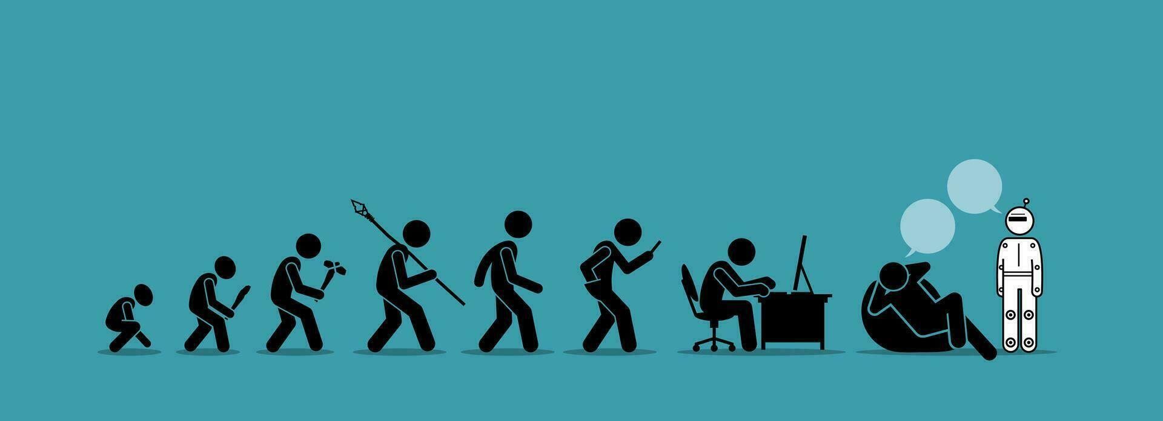
Conclusion
Computers evolved from Abacus → A1.
Each generation made computers smaller, faster, cheaper, smarter.
Future = limitless possiblities.

Slide 12
References
Textbooks
Internet sources(Wikipedia, Google, Chatgpt)
Images from Google

